Slide 1
Please Strictly follow the instructions on each page for better experience ☺
WANG ZIJIAN U1722613E
CZ2004 SSP5 A26
UKHRAWIAH BINTE SURATMAN(A25) reviewed my lo-fi during example class 3

Slide 2


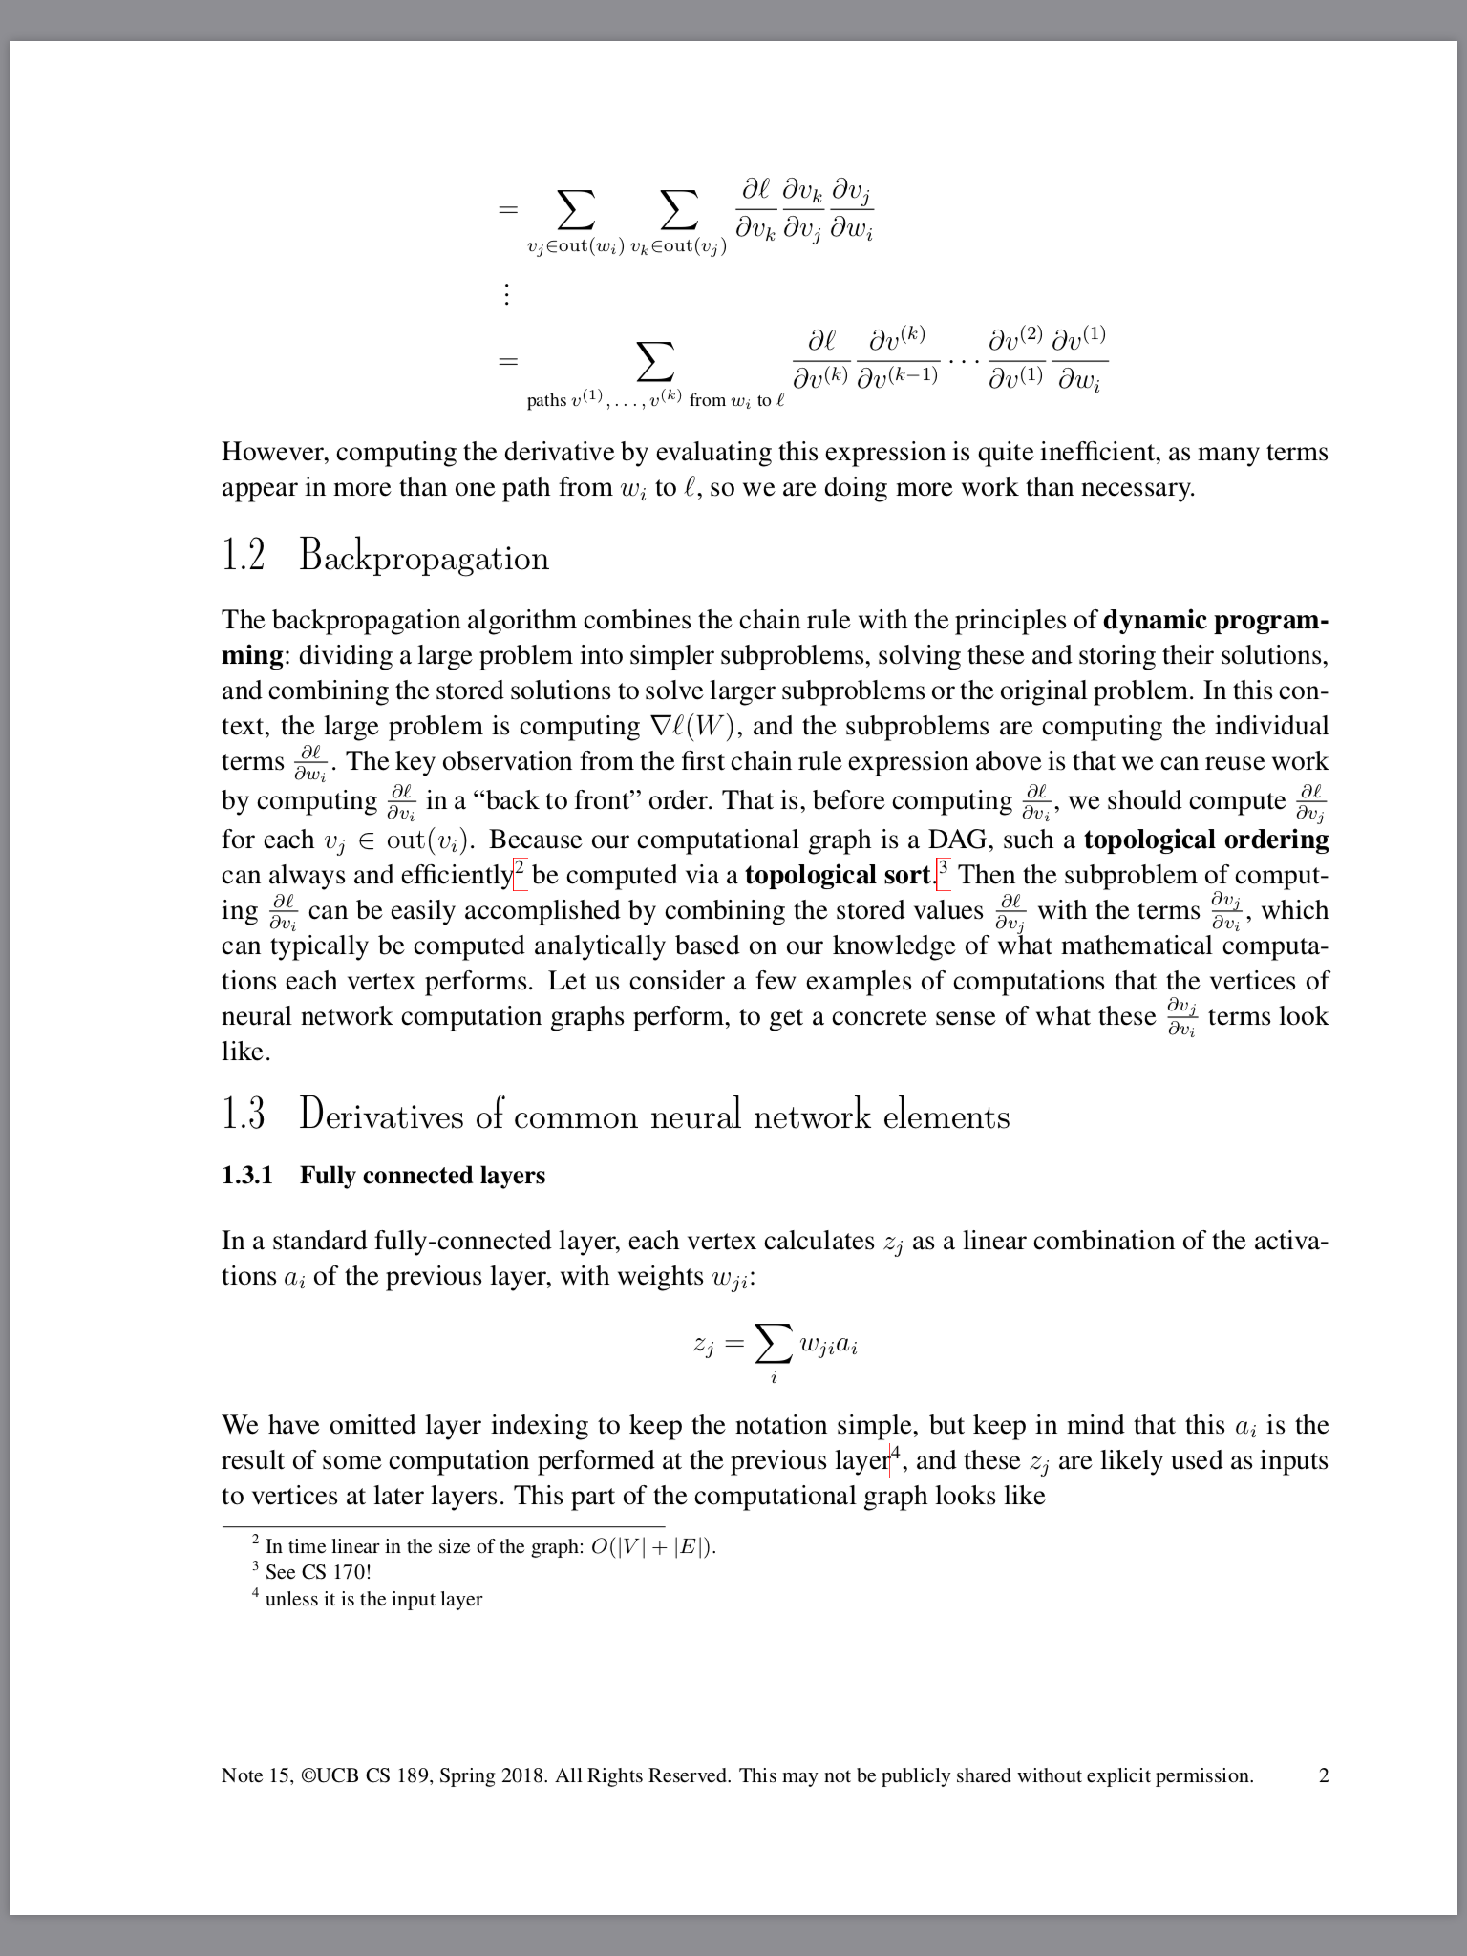

Home/Book selection
Academic Reader
Select
Search
A
B book
Introduction to Machine learning
This is the Home page where user will see when he first open the Academic Readers App.
User can select book here.
The function icons are hide during reading, user can click anywhere on the screen to see them
e.g. Click the book here to enter my design’s main interface.
Next slide

Slide 3



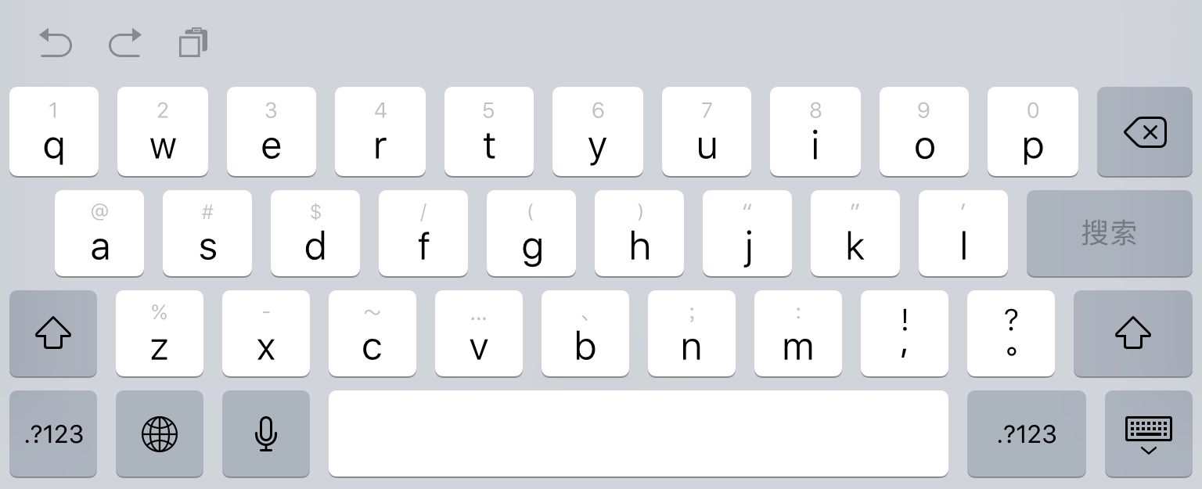






Main interface
1 Introduction
1.1 A Taste of Machine Learning
1.1.1 Applications
1.1.2 Data 7 1.1.3 Problems
1.2 Probability Theory
1.2.1 Random Variables
1.2.2 Distributions
1.2.3 Mean and Variance
1.2.4 Marginalization, Independence, Conditioning, and Bayes Rule
1.3 Basic Algorithms
1.3.1 Naive Bayes
1.3.2 Nearest Neighbor Estimators
1.3.3 A Simple Classifier
1.3.4 Perceptron
1.3.5 K-Means
2 Density Estimation
…
…
…
Machine L
Machine Learning P2 Machine Learning P6
Instructions: (actions in red can be performed by mouse)
1. Click to show index;
1.1 Click again to hide index;
2. Click to show precise search;
2.1 Enter word or page number (animation);
2.2 Matched results will automatically generate a list;
2.3 Click the result can go to exact page.(no animation for this)
2.4 Click again to hide search
3. Click < to return to Home/Book Selection
The above 3 functions are not the main features of the app so let’s go to next slide to check five main functions on the bottom bar.
Next slide

Slide 4

Function1: Tag Clouds
Instructions: (actions in red can be performed by mouse)
Click to show automatically generated keywords (tag clouds);
Click on tags will direct to the page where it appears;
If user is not satisfied with the displayed keywords, click for another batch( I did not do animation for changing the words because it’s too hard).
Click again to exit this function.
This is a key feature
Kernel
DEF
Jacobian
ABC
Hessian
SVM
Quadratic
Linear
Linear Regression
App
SQL
Next slide

Slide 5
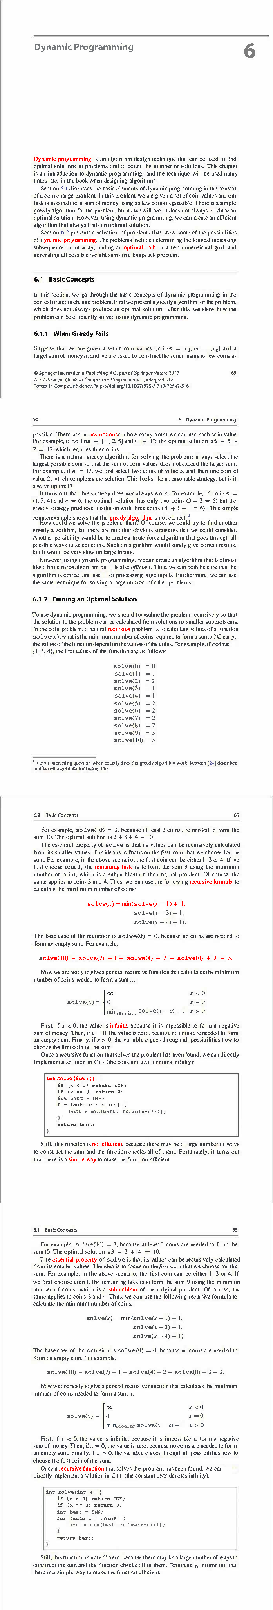
Function2: Rapid Skimming
Instructions: (actions in red can be performed by mouse)
Click to enter Rapid Skimming mode;
Press and hold to skim previous pages;
Press and hold to skim following pages;
Click again to exit Rapid Skimming mode ( in normal reading mode, user just simply swipe left and right to flip page)
Keywords/important words will be highlighted/colored in this mode
This is key feature 2
Next slide

Slide 6
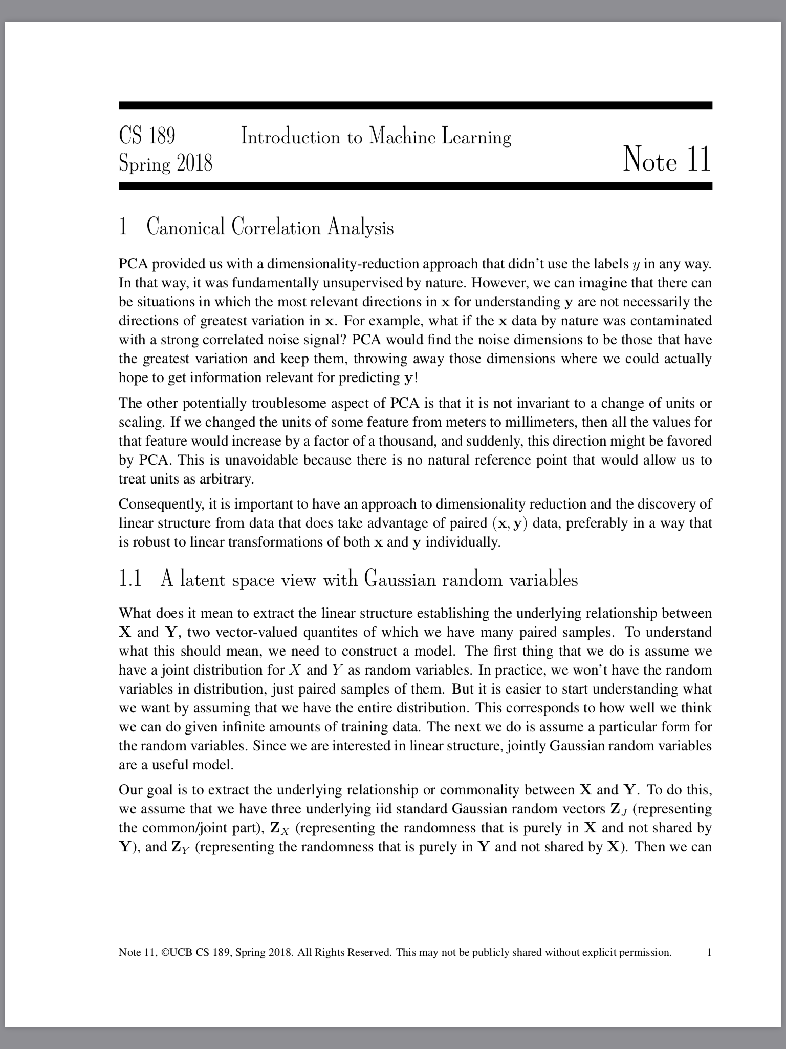
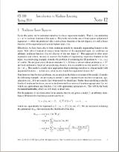
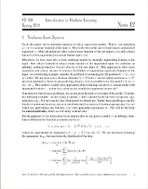
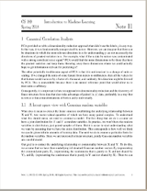
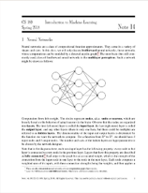
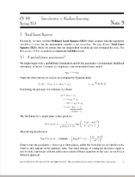
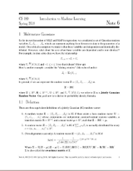
Function3: Preview
Instructions: (actions in red can be performed by mouse)
Click to preview pages around current page;
Click any page to go to that page(You can only click page 25 to go to page 25 here)
3. (This is not a key feature)
P23
P24
P25
P28
*Current Page
P26
P27
P28
P29
P30
P31
P25
Next slide

Slide 7

Function4: Bookmark
Instructions: (actions in red can be performed by mouse)
There are already 2 bookmarks being placed;
Click to place floating bookmark on current page P97 (at most 3 bookmarks can exist at the same time);
Drag floating bookmark to to cancel it (hard to do animation); Or on click again to cancel the floating bookmark;
Click 27 to visit page 27;
Click 68 to visit page 68;
Click 98 to visit page 98;
At page 98, click again to cancel floating bookmark;
(animation for the other two floating bookmark are hard to implement)
This is key feature 3
Page 98
Page 68
Page 98
Page 27
98
27
68
Next slide

Slide 8
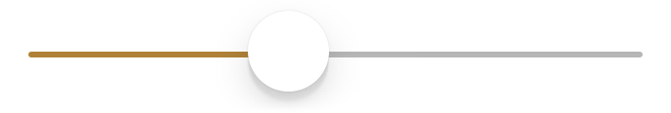
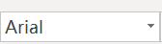
Function5: Adjust theme
Instructions: (actions in red can be performed by mouse)
User can change fonts, size, theme and other custom settings here.
Click to enter setting interface;
Any change will appear simultaneously ( hard to do animation here)
Click again to exit setting interface;
This is not a key feature.
A
A
Fonts
Theme
Next slide

Slide 9
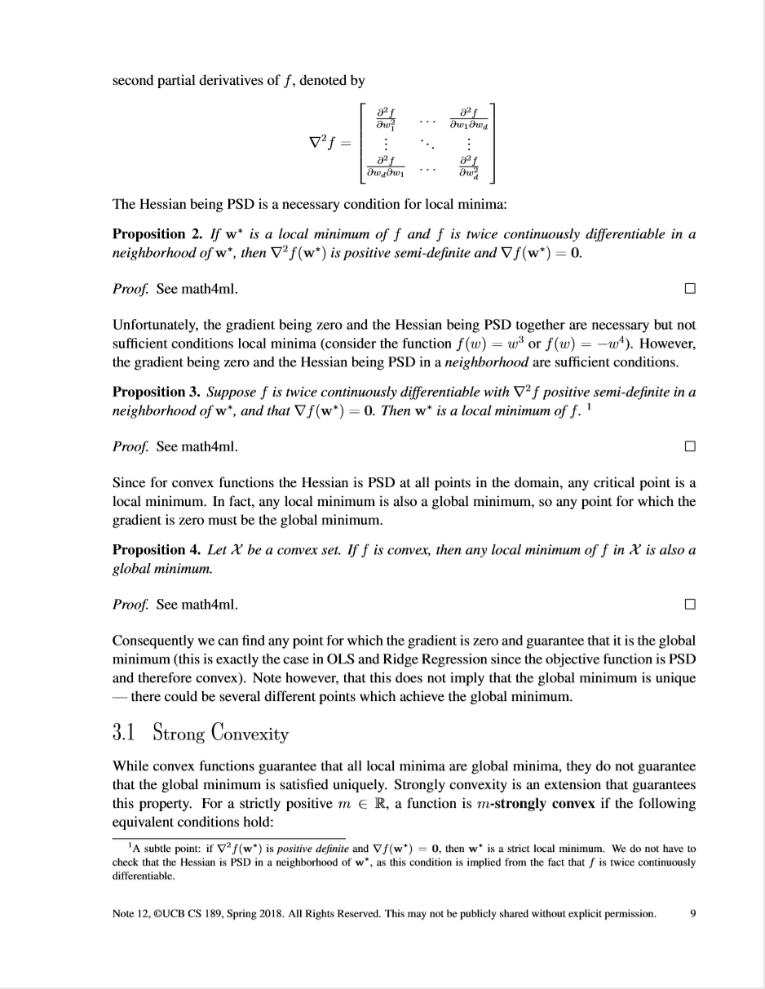
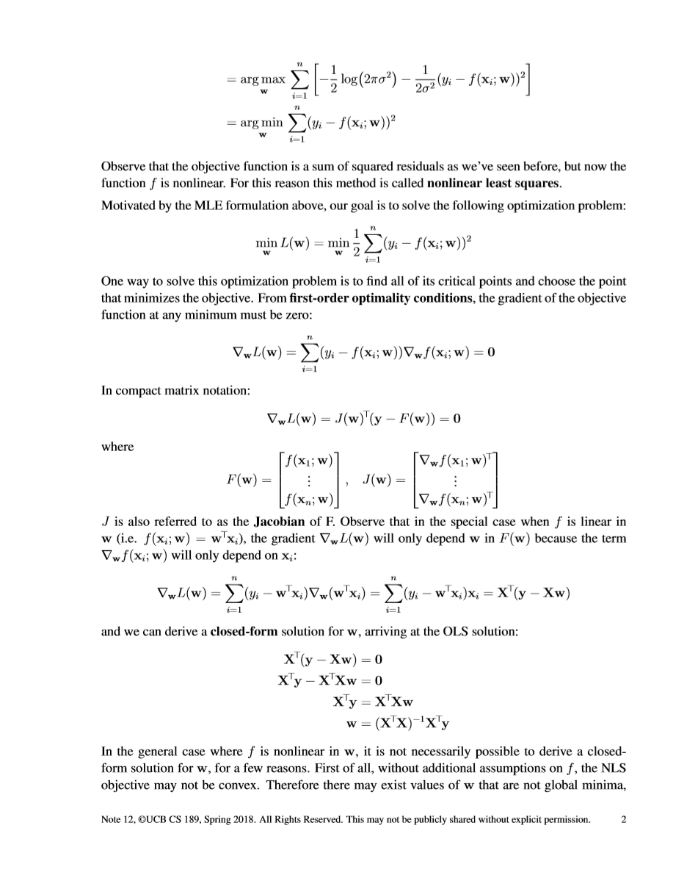
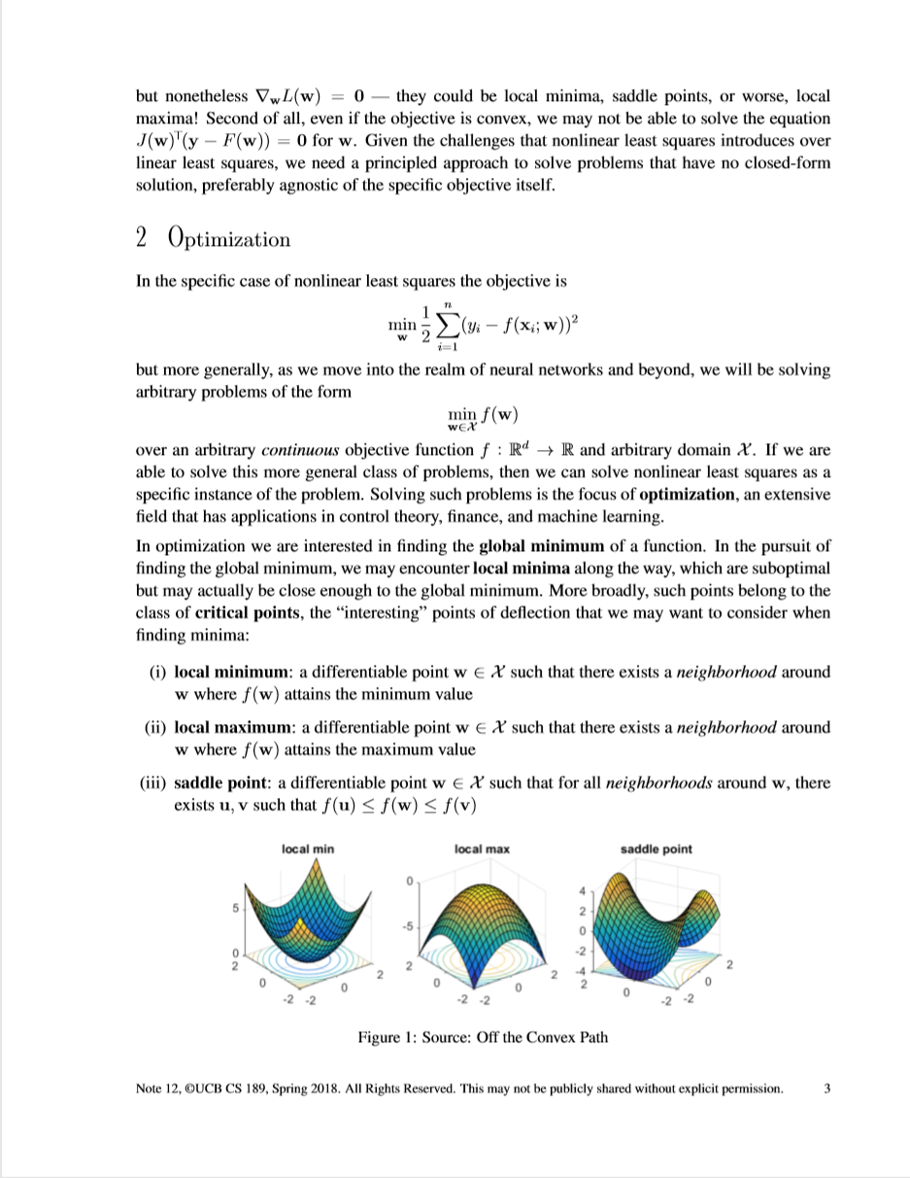

Function when tablet is in landscape mode:
Switch from Continuous mode to non-continuous mode.
In non-continuous mode, the screen can display two non-adjacent pages at same time.
Click “C” to enter non-continuous mode where other functions works the same as in portrait mode;
Click “C” again to exit.
2
9
3

